Slide 1
Outline chapter one
Introduction to Interactive Computer Graphics
Introduction about computer graphics
Brief history of computer graphics
3D Graphics Techniques and Terminology
Common uses of Computer Graphics
Examples of Application Areas

Slide 2
Introduction about CG
Generation (from models) and manipulation of images using a computer as a rendering tool is called computer graphics.
An image can be defined as a two-dimensional function, f(x, y), where x and y are spatial(plane) coordinates and the value of f at any coordinate(x, y) is called intensity.
When x, y and the value of f is finite(discrete) quantities the image is known as Digital Image.
Pixel:-the building block of an image. f(x, y) where x=0 to M-1 and y=0 to N-1.

Slide 3
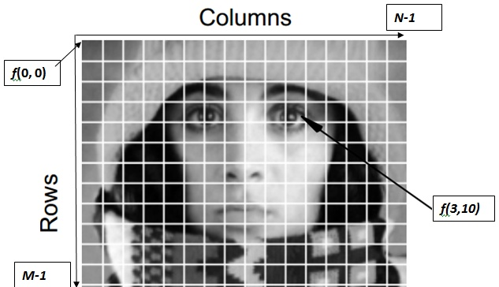
Introduction about CG cont’d
By convention, the origin of the image is located at the top-left most corner i.e f(0, 0).
The center of the image is at f ((M-1)/2, (N-1)/2)

Slide 4
Types of computer graphics
Based on user interaction
Interactive CG :- games
Non-interactive CG:- screen saver, wallpaper
Based on image format
Raster CG
Vector CG
Based on dimension
2D
3D

Slide 5
History of Computer Graphics
First Generation (1951 - 1959)
  UNIVAC (1951)
  Crude hardcopy devices (line printer pictures)
Data was displayed on printers or hardcopy plotters
Computers were “number crunchers”; hardware was expensive!
First computer-driven display (Late 50s and early 60s)
  attached to MIT’s Whirlwind I computer
  display was CRT similar to one used in TV sets

Slide 6
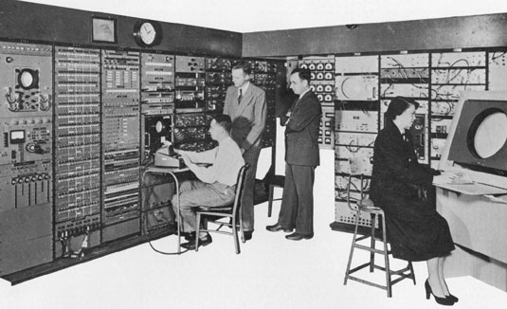

Slide 7
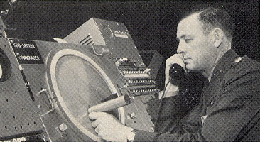
Computer Graphics History continued
SAGE air-defense system (mid 50s) used command & control CRT
used CRT display consoles on which operators identified targets with light pens

Slide 8
Computer Graphics History continued
Beginnings of modern interactive graphics attributed to Ivan Sutherland’s doctoral work
  presented work at Spring Joint Computer Conference in 1963 in the form of a movie.
  He developed the Sketchpad drawing system

Slide 9
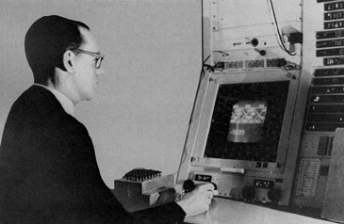

Slide 10
Sutherland’s work continued
  the system included interactive techniques that used the keyboard and light pen for making choices, pointing, and drawing
He formulated the ideas of
  display primitives (lines, polygons, arcs, characters)
  constraints on primitives
  developed algorithms for dragging, clipping,
  transforming (rotating, scaling, translating)
  introduced data structures for storing hierarchies built up via easy replication of standard components

Slide 11
More Sutherland
He is considered to be the founder of the computer graphics field
Because of his work, CAD & CAM became attractive
By the mid-sixties, much research was being done

Slide 12
Computer Graphics of the 60’s
Hardware expensive
large scale, expensive computing resources needed
About 1965, IBM brought out the first widely available interactive computer graphics terminal
  vector graphics display
  sold for more than $100,000
  only elite designers could use the display system

Slide 13
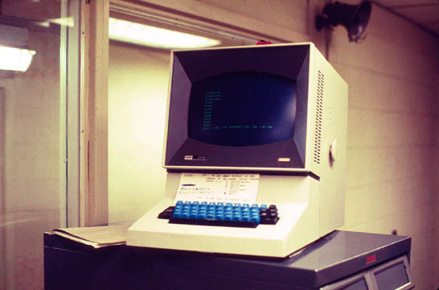

Slide 14
More Developments
The next landmark was a special type of CRT produced by Tektronix - the direct-view storage tube (DVST)
Introduced in 1968
  complete with keyboard, mouse, simple computer interface for $15,000
  made interactive computer graphics affordable

Slide 15
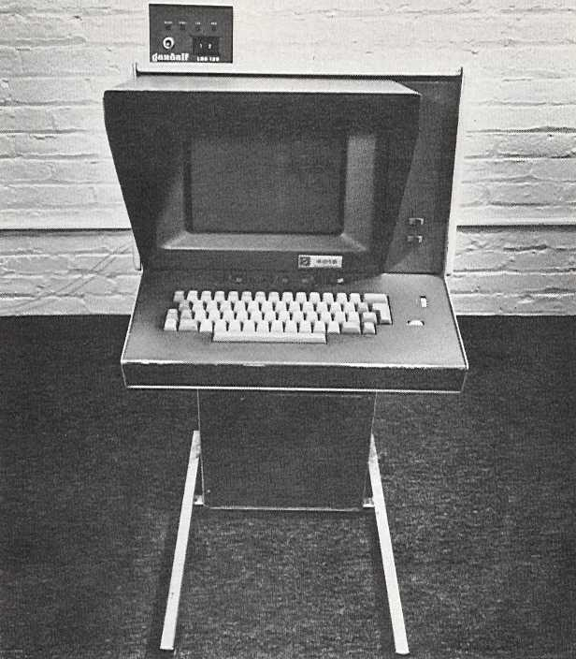

Slide 16
Where did graphics go next?
By late 60’s many researchers were concerned with dynamic graphics.
Realistic flight simulation applications were needed
To make them realistic, solid colored surfaces were needed (not wireframe)
TV raster displays were used to create such images

Slide 17
Raster Graphics continued
Xerox Palo Alto Research Center designed a new graphics-based personal minicomputer called the Alto
Design was based on:
  cost of computing falling - every “knowledge worker” should have a personal computer
  Alto computers should be connected for communication & resource-sharing
  interface between user & computer should be graphical
  graphics display should be based on raster-graphics technology

Slide 18
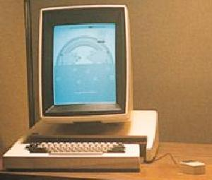
Xerox Alto

Slide 19
More hardware development’s
PC’s in the 80’s
  costs decrease drastically
  built-in raster displays
  bitmap graphics used

Slide 20
Software Developments
Sketchpad graphics
Early days software was non transportable at the assembly language level
Push in 70’s for high-level, machine- and device-independent graphics subroutine packages
The awareness of the need for standards culminated in
  specification of the 3D Core Graphics System
  produced by an ACM SIGGRAPH Committee in late 70’s
  used as input to official standards projects within both ANSI and ISO

Slide 21
Software continued
First graphics standard was GKS (1985)
  like Core but 2D
PHIGS (Programmer’s Hierarchical Interactive Graphics System) was a 3D extension of GKS became an ANSI standard in 1988
OpenGL was introduced by SGI in 1992
  has portable, interactive 2D and 3D graphics applications
  low-level, vendor-neutral software interface
  broad platform accessibility in the industry

Slide 22
Software
Sun formally announced Java in 1995
  Developed by James Gosling (originally called Oak)
  Considered to be a software development platform-- includes graphics & windowing capabilities
    Java AWT (Abstract Windowing Toolkit)
    Java 2D
    Java 3D

Slide 23
3D Graphics techniques and terminology
Modeling = representing 3D objects(polygons, quads, etc.)
Rendering = constructing 2D images from 3D models
Texture mapping:- covering a geometry using images.
Morphing :-shifting pixels from one location to another.
Rasterization:- geometry to pixels
Transformation( translation, rotation, scaling, shearing)
Animation = simulating changes over time

Slide 24
3d graphics techniques and terminology cont’d
Shading:-modeling light interaction with 3D objects.
Hidden surface removal:-display only visible part of an object.
Vertex:- point in 3D
Edge:-line in 3D connecting two vertices
Polygon/Face/Facet:-arbitrary shape formed by connected vertices, fundamental unit of 3D computer graphics
Mesh :-set of connected polygons forming a surface (or object)

Slide 25
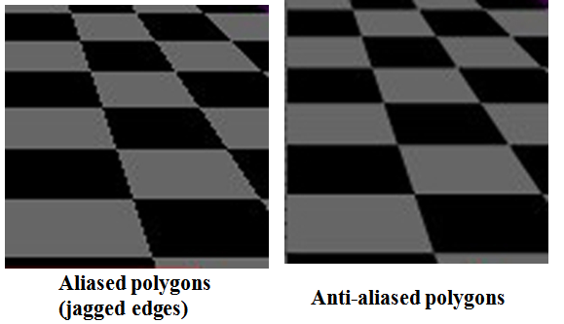
3d graphics techniques and terminology cont’d
Aliasing: distortion object produced when representing a high-resolution signal at a lower resolution.
Anti-aliasing:- a technique used to remove aliasing.

Slide 26
CG uses and application areas
Entertainment:- games, movies, special effects
Computer-aided design:- design bridge, dam, machines
Scientific visualization:- how our body works
Training:-flight, driving simulation.
Education:- to teach anatomy.
E-commerce:- virtual phone store.
Computer art:- drawing monuments, palaces and church

Slide 27
Question and answer?
End of chapter!!

